Slide 1
Chemiresistive Smo-sensors
Name : Karthikeya Hanu Prakash Kanithi
Roll No : EE22BTECH11026

Slide 2

Index
What are SMO sensors and their applications?
Working of SMO sensors
Construction and Circuit network of SMO sensors
Parameters that affect SMO sensors
Challenges of the SMO sensors
Sensor power efficiency
My POV of the best application of the SMO sensors

Slide 3

What are SMO sensors and their applications?
Chemiresistive SMO sensors leverage variations in electrical resistance to detect specific external gases, providing a reliable sensing principle.
These sensors are favored for their compact dimensions, cost-effectiveness, and seamless integration with electrical circuits, enhancing their practical utility.
Amidst escalating air pollution levels, SMO sensors assume a crucial role in monitoring concentrations of harmful gases such as BTX, $SO_{x}$, etc., safeguarding public and environmental health.
In contrast to bulky and expensive modern pollutant/VOC detectors, SMO sensors offer a compelling alternative with their compact size and affordability, showcasing significant potential for widespread adoption.
SMO sensor-based exhaled breath analysis has emerged as a prominent research area, fueled by recent advancements in analytical instruments, contributing to the exploration of novel diagnostic techniques.
The idea of non-invasive, painless, and point-of-care health monitoring has always attracted scientists, reflecting their promise in transformative healthcare technologies.

Slide 4
Working of SMO sensors
Detecting the concentrations of various biomarkers like ammonia, acetone etc can reveal the severity of the disease associated with the biomarker. Hence, SMO sensors based on exhaled breath analysis have a vital role in the future of medical applications.
Generally, SMO sensors are insulators in room temperature.
However, Defect bands exist in the SMO sensors based on the type of the SMO sensor.
n-type SMO sensors have donor-type defect bands, and p-type SMO sensors have acceptor-type, defect bands.
When the temperature is increased, electrons get excited from,
Oxygen, because of its high electronegativity, binds with the electrons on the surface of the SMO sensor, forming EDL (Electron depletion layer) and HAL (Hole accumulation layer) in n-type and p-type sensors, respectively. [chemisorption]
Donor type defect bands ➔ Conduction band (n-type)
Valance band ➔ Acceptor type defect band (p-type)

Slide 5
Working of SMO sensors
When the reducing gases / VOCs interact with the surface of the sensor, the chemisorbed oxygen oxidizes the reducing gas. In this process, the oxygen is consumed, and the bound electrons are released to the EDL/HAL, therefore decreasing/increasing the resistivity of n and p-type SMO sensors, respectively.
After the reducing/VOC gas is removed, the sensors return back to their original resistance. The time in taken for the sensors to return back to their original resistance is known as the recovery time. The exact opposite process happens in the presence of an oxidizing gas.
The extent to which the resistance of the gas sensor changes in the presence of that particular gas is known as the sensitivity of the given sensor towards that particular gas.
The sensor should be thermodynamically stable at its operating temperature. Generally, thermodynamic.
The temperature at which the SMO sensor operates is known as the operating temperature, and the temperature at which we obtain maximum accurate results of the concentration of the targeted gas is known as the optimum temperature.

Slide 6
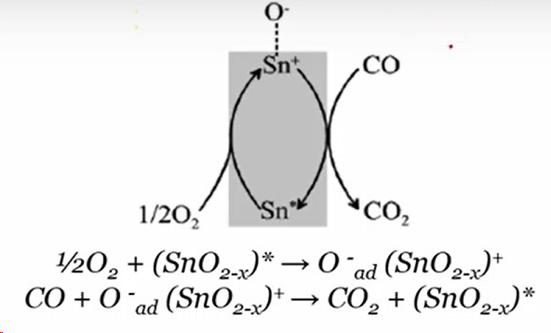
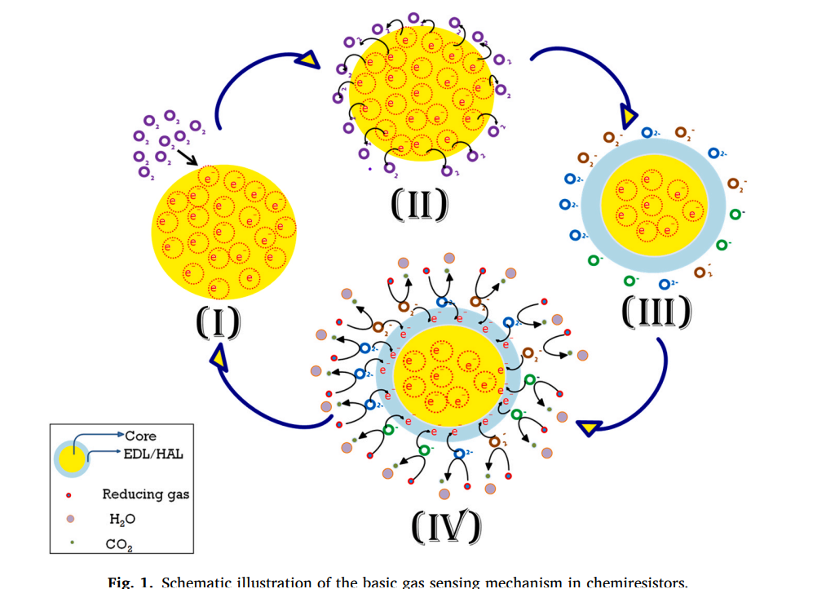
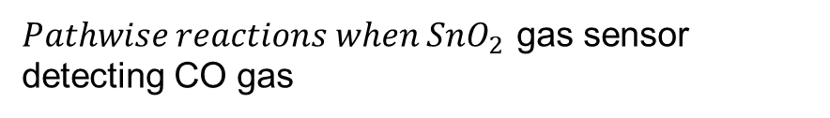
Working of SMO sensors
$Pathwise reactions when SnO_{2}$ gas sensor detecting CO gas
Schematic Representation of basic gas sensing mech.

Slide 7
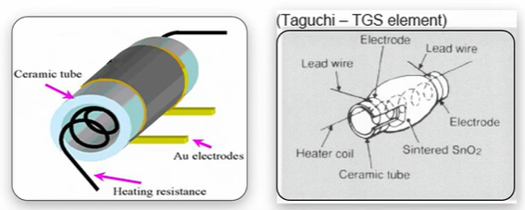
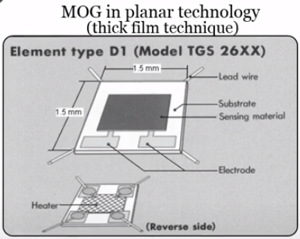
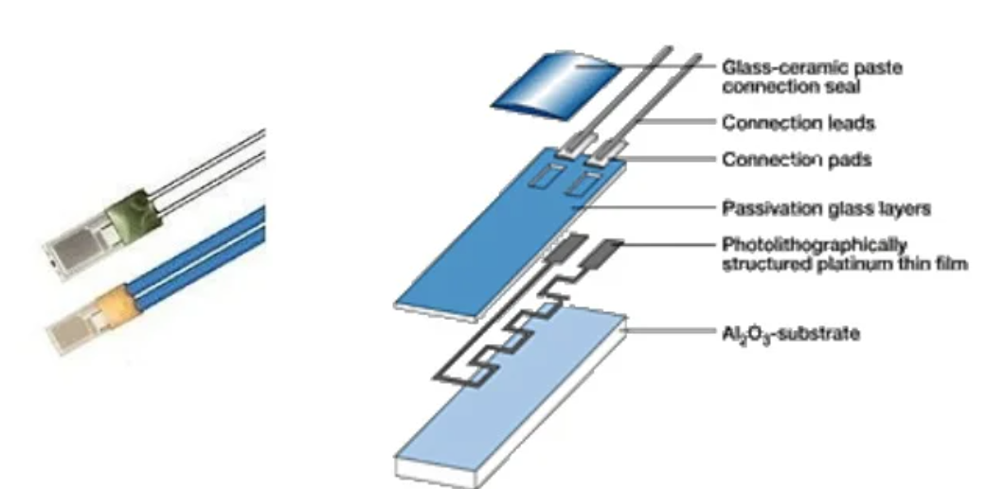
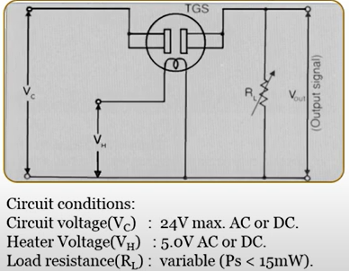
Construction and Circuit network of SMO sensors
Conventional Sensor construction
Thick film sensors
Thin film technology sensors
Circuit build of the sensor

Slide 8
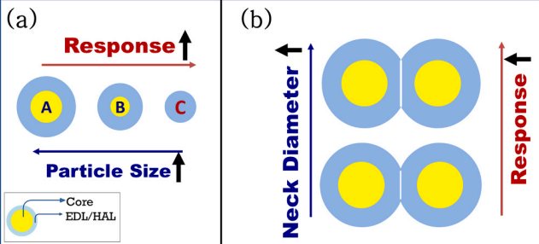
Parameters that affect SMO sensors
Some of the characteristics that affect the response/selectivity/sensitivity of the sensors are
Grain size and the neck area:
Generally, in n-type SMOS, the grain size of SMO is indirectly proportional to the resistance of the sensor and surface energy.
However, in p-type SMOS, the neck area between two grains is the most important when compared to the grain size. It’s mostly because the neck region is the bottleneck of the charge transport system in a p-type semiconductor.
Also, we can’t keep on decreasing the grain size because if they are ultra-small particles, then due to the high Vander walls, the grains agglomerate together and reduce the surface area. Thermal stability will also be difficult to attain at high temperatures.

Slide 9
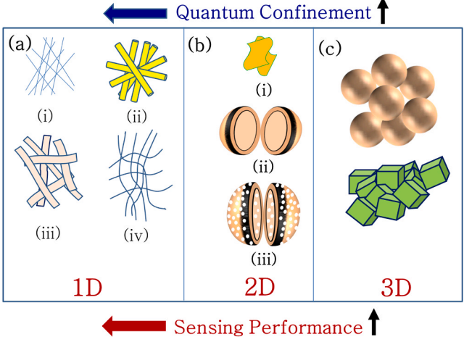
Parameters that affect SMO sensors
Particle morphology:
Chemisorbed oxygen is pivotal to the sensing mechanism of the sensor. Therefore, the surface area of the SMO sensor plays a huge role in improving the properties of the sensor, such as resp-recovery times and selectivity.
Specific surface area can be increased by increasing the surface-volume (S/V) ratio. A higher S/V ratio and a better sensor response can be obtained by tailoring the particle morphology.
Generally, the greater the quantum confinement of the particle, the better the sensor response. But particles with lower confinement have different advantages like a high concentration of active sites, more channels for facile gas movement, etc. Therefore, the morphology must be chosen carefully to provide maximum overall results.
(a) 1-D nanostructures: (i) nanowires, (ii) nanotubes, (iii) nanobelts, and (iv) nanofibers (iv); (b) 2-D nanostructures: (i) nanosheet, (ii) hollow nano/microsphere, and (iii) porous nano/microsphere; (c) 3-D nanostructures.

Slide 10
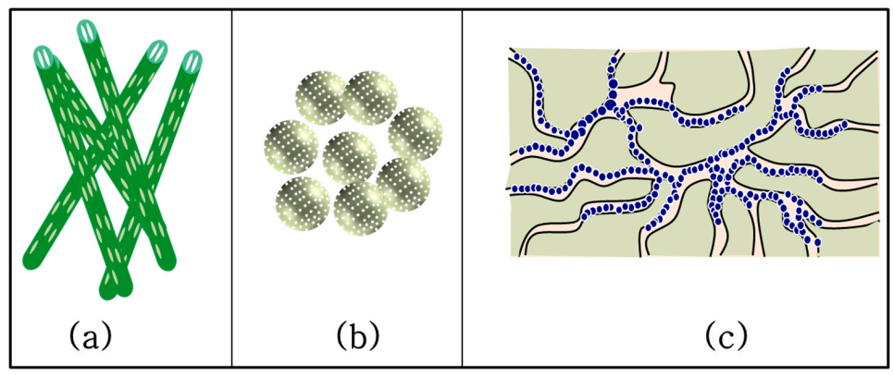
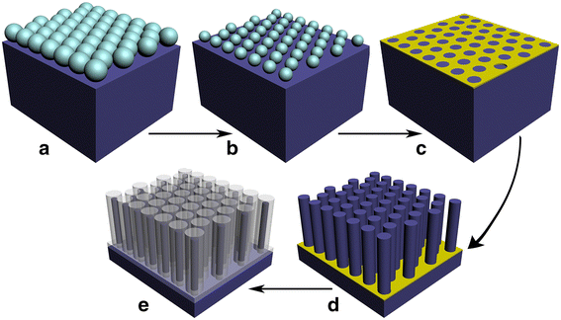
Parameters that affect SMO sensors
Porosity:
It has been observed that SMOs with porosity have shown excellent response to selective gases when compared to their non-porous/ densely packed versions.
Organic sacrificial templates were used to create ordered mesoporous/bimodal porous to enhance the sensitivity, response, and also selectivity of the sensor in some cases.
Nano-casting is a process where silica is used as the sacrificial template.
Different gases have different diffusion speeds through the porous holes of the SMOs, through which the sensitivity of the sensor towards certain gases can be controlled.
In another technique to create porosity, the nanomaterial is incorporated in a mesoporous silica matrix.
(a) Porous Nano-rods (b) Porous Nano-sphere (c) Porous Nano-fibres
Nano-casting using silica template

Slide 11

Parameters that affect SMO sensors
Doping with other metals:
Doping SMOs with noble metals, other oxides, polymers, and rGO has been shown to increase the selectivity of the sensors and sometimes other properties, too.
Doping with appropriate dopants can reduce the cross-sensitivity towards humidity and other gases, too. It can also enhance the sensitivity towards a particular gas.
Doping with noble metals can also enhance the ability of the SMO to absorb the target gas. For example, Pd can absorb $H_{2}$gas up to 900 times its own volume, So Pd coating can greatly enhance $H_{2}$ gas sensitivity.
Doping with noble metals can also enhance the sensor response by chemical (split-over process) and physical (band-bending) sensitization. {Not diving too deep into them}
Doping with hetero-atoms can also effectively increase the sensor response, as hetero-atoms can act as growth inhibitors.
Crystalline phases, Humidity, Hetero/Homo junction Mos, Acid-Base interactions, Light activation etc, are few other major parameters that affect the performance of the sensors.

Slide 12
Challenges faced by SMO sensors
Some of the challenges faced by the sensors that affect their long-term stability are listed as,
Mechanical attrition and erosion of sensing film, lack of adhesion between substrate and sensor film, thermal expansion mismatch between substrate and sensor film, etc., can damage the thick film sensors in the long run. To avoid these, we can either exploit the MEMS platform or use thin film sensors.
Heater and Electrodes should be thermally stable. If either of them gets affected, then the working temp/ operating temp and the properties of the sensor will change drastically. Ta/pt thin film heater designed by Chen changes its resistance (~20 times) slower.
Pt is way more stable than Ag/Au as an electrode, but it does not provide adhesion for the substrate. Pt with Ti sublayer can solve this issue
The sensor should be thermodynamically stable at its operating temperature. Generally, the thermodynamic stability of metal oxides increases as the formation energy of the metal oxide increases. Therefore, enhanced thermal stability can be attained by high energy synthesis processes.

Slide 13

Challenges faced by SMO sensors
My Aim and Goals for the Future
The sensor should be chemically stable and contain no highly reactive ions like $Na^{+}$and $Cl^{−}$. They affect the long-term stability of the sensors.
Dopants present in quantities less than their solubility limits enhance the sensing properties of the sensors, but if the dopants are present in higher quantities, then they occupy the grain boundaries of the primary particles and can change the chemical and physical properties of the sensors.
In thin-film sensors, cracking of the sensing layers is a huge concern that affects the temporal stability of the sensor. It can be prevented by the proper selection of additives in the sensor.
Surface migration of noble metals( used for sensitization ) can also affect the temporal stability of the sensor. The metal atoms concatenate together to form a huge cluster that affects the performance of the sensor. Generally, noble metals with a bigger grain size or thick catalyst layer, when doped, will result in better temporal stability of the sensor. However, too much increase in the catalyst layer will also affect the performance of the sensor. So, a good balance is required.

Slide 14
Challenges faced by SMO sensors
My Aim and Goals for the Future
Generally, sensors with a grain size < 5nm are unstable. As we increase the temperature, the grain size also grows due to the extremely small grain sizes initially. This results in the sensitivity of the sensor to decrease as discussed before. So, a thorough optimization is required for the perfect grain size to obtain the best results from the sensor.
Use of highly crystalline and single crystalline nano-particles can provide enhanced stability.
Exploitation of mono-dispersed nano-particles is also prescribed for achieving temporal stability of the sensor.
Humidity is one of the biggest concerns regarding the long term stability of the sensors. The chemisorption, physisorption and condensation of the ambient moisture on the sensor’s surface can affect the electronic properties of the sensor. Thus, the SMO sensors face a long-term drift on both resistance / conductance and the sensor response by inhibiting surface adsorption of the target analytes/ gases.

Slide 15
Challenges faced by SMO sensors
My Aim and Goals for the Future
Some ways to reduce the affect of humidity on the sensor are given as follows
Sensors prepared at high temperatures are less prone to humidity. Sensors prepared at 400-500°C have no cross interference from humidity. But temperatures lead to high power consumption.
Suitable doping can also reduce the cross-interference of the sensor towards moisture.
Increasing the size of the porous holes can also reduce the affects of humidity on the performance of the sensor.
Due to their crystalline single nature, !-D nano-structures are less prone to the moisture affect.
Surface pretreatment is another great way to prevent the cross-interference with humidity.
Poisons of surface adsorption, progressively deactivate the sensor with time. Noble metals that are used as dopants can also be poisoned by N ,P ,As ,Sb etc,. Catalyst poisoning is also one of the biggest concerns especially in harsh/polluting operating conditions. Surface regeneration by controlled oxidation on high temp can solve the problem up to an extent.

Slide 16
Sensor power efficiency
The high-power consumption of SMO gas sensors is mainly due to their operational temperature and heating elements. The power consumption can be optimized by taking some cautious measures:
Aliovalent doping can reduce the optimum temperature of the sensor and enhance power consumption.
Utilizing thin film sensor development also represents a highly effective strategy for optimizing power consumption in SMO gas sensors.
Optimizing power consumption can be notably enhanced through the implementation of non-stoichiometric oxide nanostructures in sensor development.
Optimizing power consumption can also be achieved through leveraging high S/A nanostructures, such as nano-wires, belts, etc., for enhanced efficiency in sensor development.
Certain SMO sensors exhibit the capability to detect target gases upon exposure to ultraviolet (UV) radiation, providing an opportunity to reduce operational temperatures and thereby optimize power consumption.
Power optimization can be done by composting SMO sensors with conducting polymers.

Slide 17
The best application of the SMO sensors
The optimal applications of SMO sensors lie in their use for Human Environmental Monitoring and breath analysis. These sensors excel in detecting various gases, making them valuable for assessing environmental conditions and analyzing breath composition for medical diagnostics and health monitoring.
In Human Environmental Monitoring, SMO sensors are employed to detect and monitor gases in the surrounding environment, providing insights into air quality, pollution levels, and potential hazards. They find applications in industrial settings, homes, and public spaces to ensure a safe and healthy environment.
But I think the most useful application of the SMO sensors is their breath analysis. In breath analysis, SMO sensors play a crucial role in assessing the composition of exhaled breath. The human breath contains various volatile organic compounds (VOCs) that can be biomarkers of specific health conditions. SMO sensors can detect and analyze these VOCs, offering non-invasive and painless methods for medical diagnostics, disease monitoring, and personalized healthcare.

